Slide 1
Applications of Variational Autoencoders and an experimental work using UNET GANs
Deep learning and Probabilistic Graphical Models Project
Presented by
Theivaprakasham H – CB.EN.P2CEN20026
June 2021

Slide 2
Objective
To explore and implement various applications of Variational Auto Encoders
To explore and implement applications on GANs

Slide 3
Probabilistic Graphical Models Concepts
Distribution Mapping
Bayesian Assumption
Variational inference (ELBO [Likelihood, KL- Divergence])

Slide 4
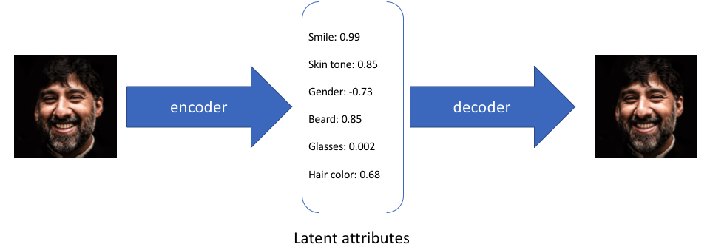
Vanilla Auto-encoder
Hidden Representation
Fewer parameters
Encoder maps an input image via an to a deterministic latent
Decoder maps the latentto reconstruct the input image

Slide 5
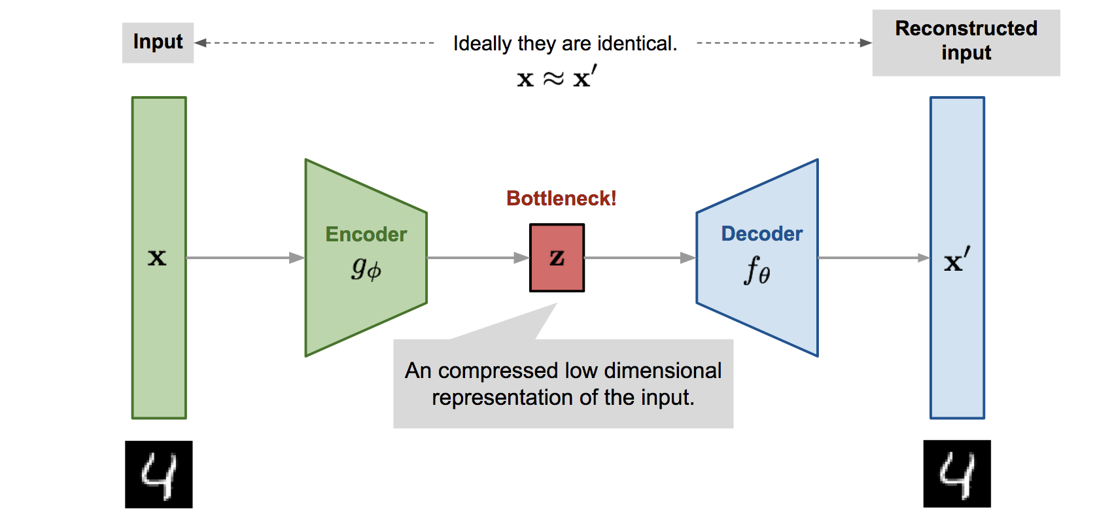

Vanilla Auto-encoder

Slide 6
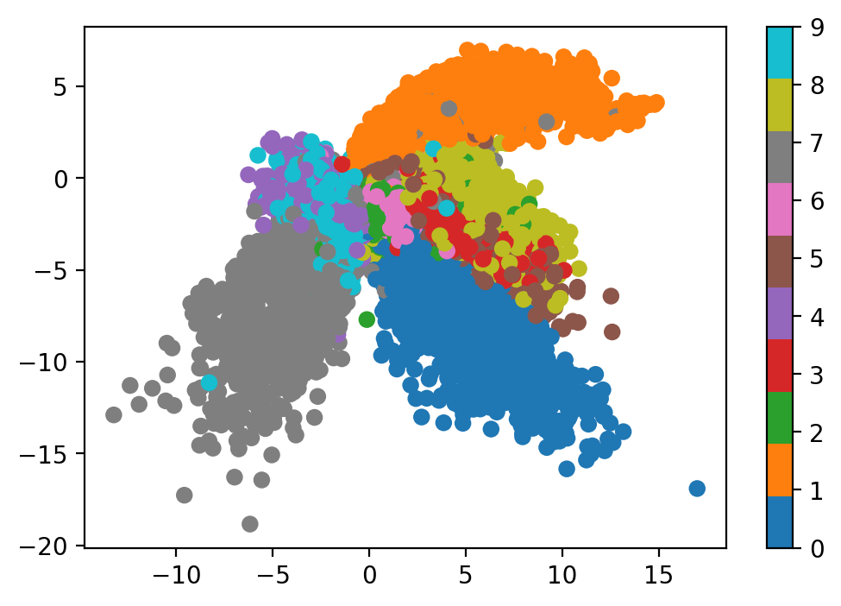
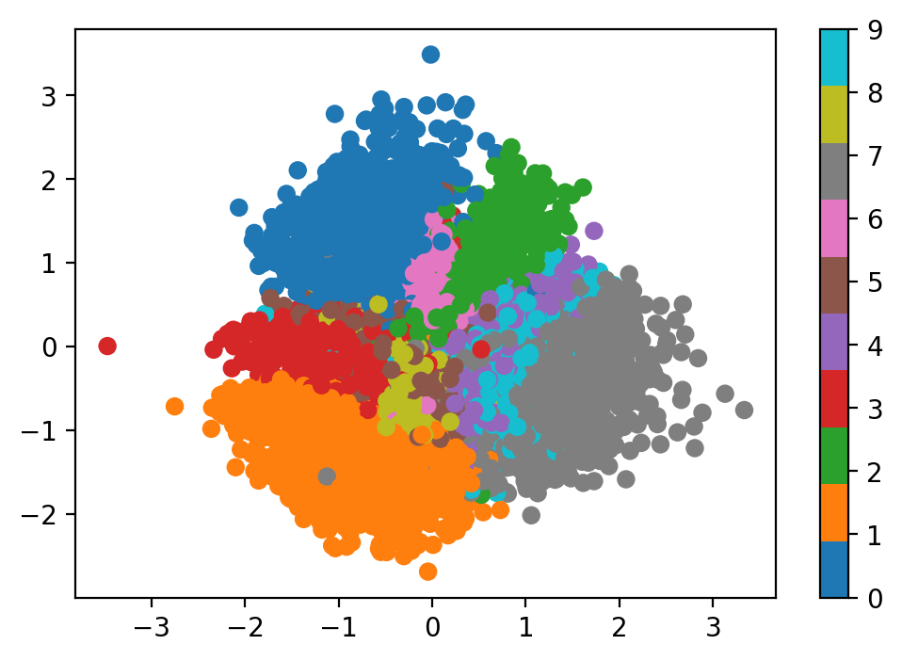
Issues with Auto-encoders
Latent vector range are discontinuous and are spread out with gaps that doesn’t support proper reconstruction
Sampling from discontinuous points gives unrealistic decoder output
AE generates exact replica of Training Set. (Memorizes the Training set)
AutoEncoder
Variational AutoEncoder

Slide 7
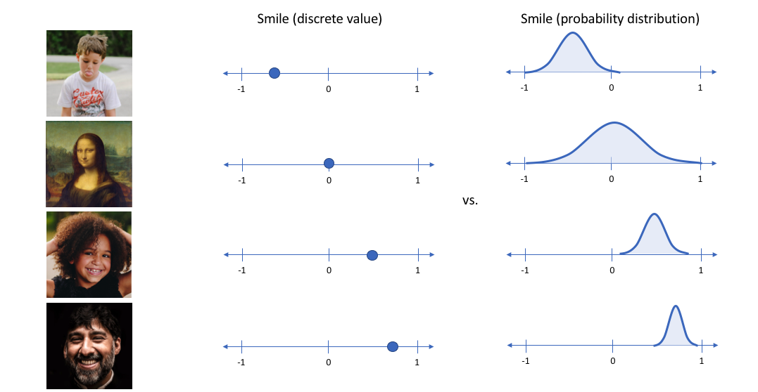
Represent each latent attribute as a range of possible values
Kingma, D.P., Welling, M.(2014) Auto-Encoding Variational Bayes.

Slide 8
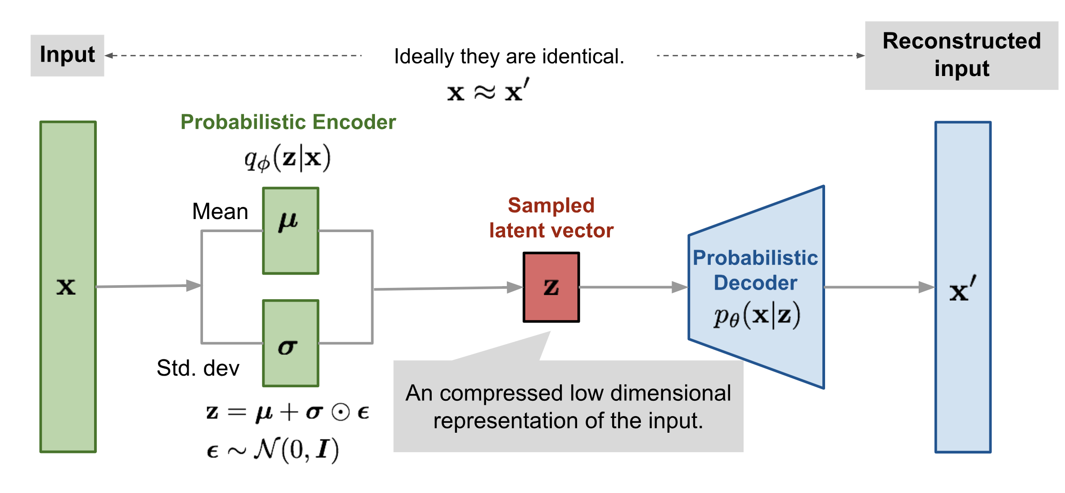
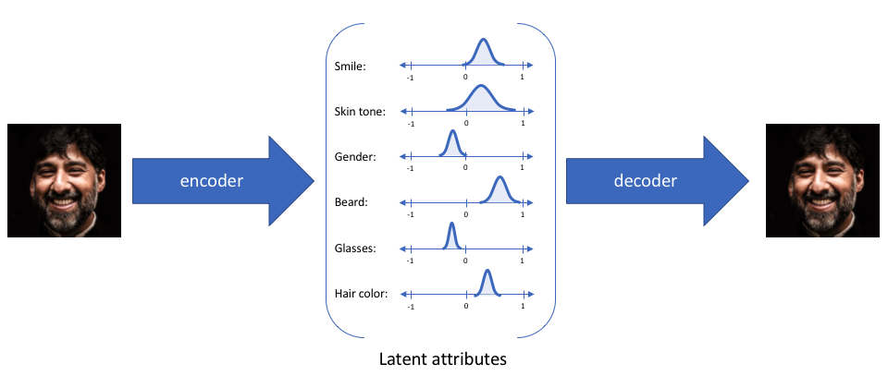
Variational Auto-encoder

Slide 9
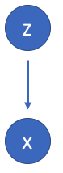
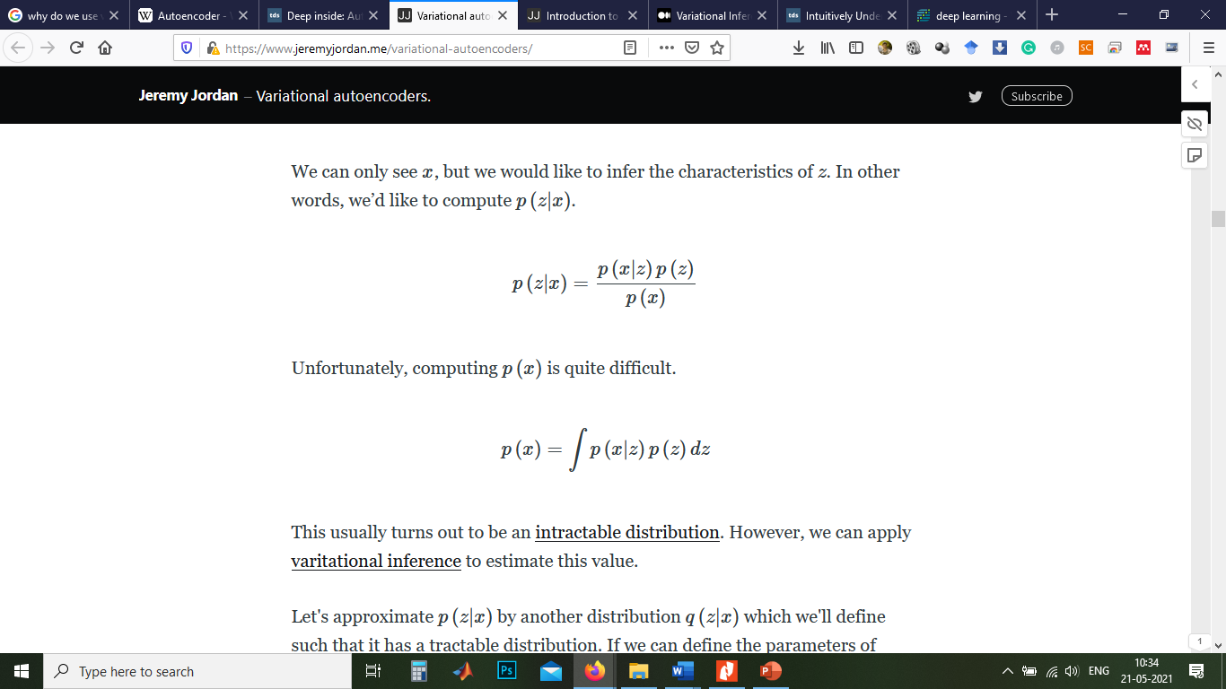
Probabilistic Motivation
Suppose that there exists some hidden variable z which generates an observation x.
hidden variable z
We can only see x, but we would like to infer the characteristics of z
Given X (image), lets try to compute Z (latent variables)
Computing p(x) is quite difficult.
p(x) (Intractable distribution - (i.e.) requires exponential time for computation)
Observation x (Image)

Slide 10
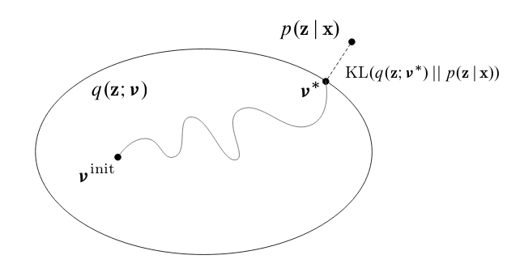
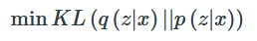
How can we solve this intractable problem?
Let's approximate p(z|x) by another distribution q(z|x) (Assume it has a tractable distribution)
Variational Inference
We can treat this as an optimization problem where we parametrize q (ie: a neural network) to try to get close to p via gradient descent.

Slide 11
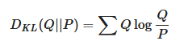
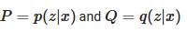
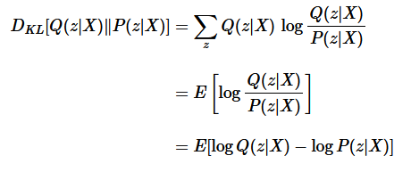
KL divergence is a measure of difference between two probability distributions.
KL Divergence of Q and P
Substituting

Slide 12
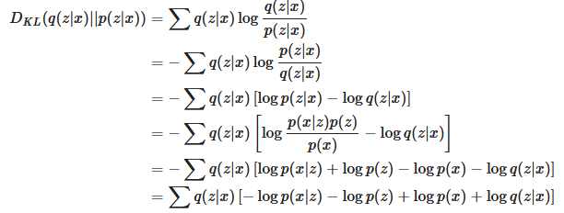
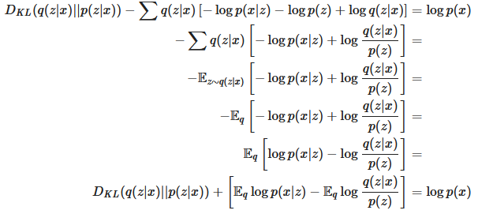
log p(x) is a constant

Slide 13
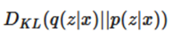
log p(x) is a constant
Maximizing this term(ELBO) will minimize

Slide 14
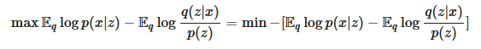
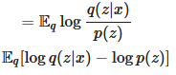
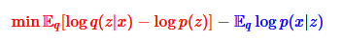
To maximize the ELBO, we can minimize the negative of the ELBO.
Final Loss to be minimized using Neural Network is
KL-divergence
Reconstruction

Slide 15
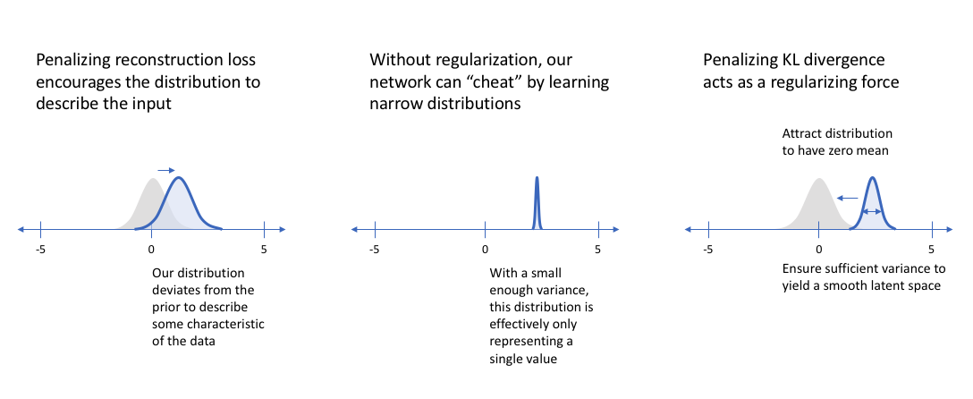
Effect of KL Divergence and Reconstruction loss
Acts as Regularizer

Slide 16
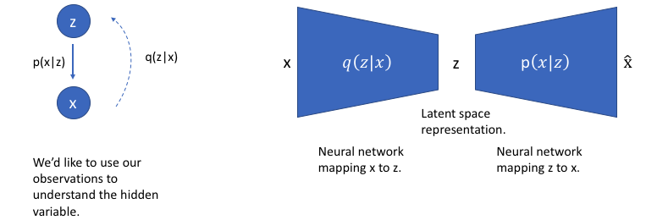
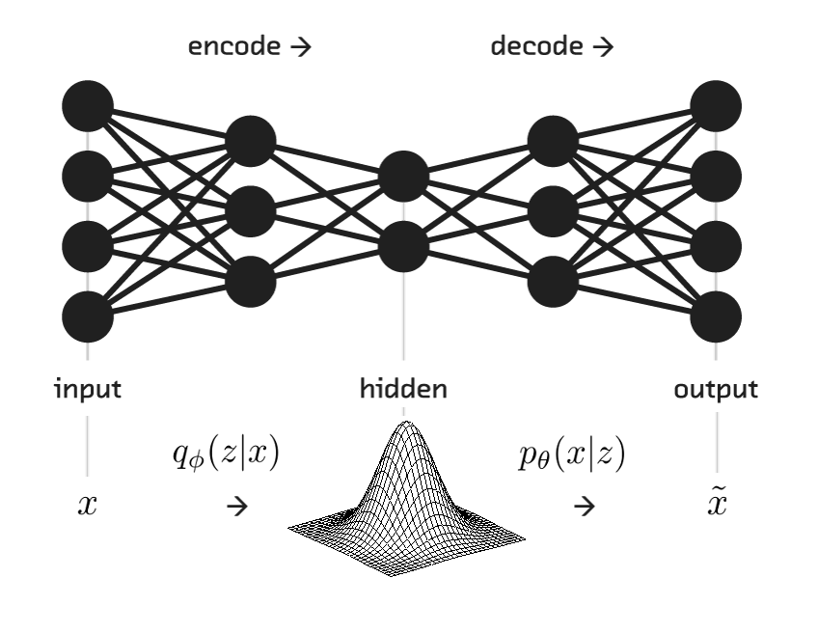
Graphical Model View

Slide 17
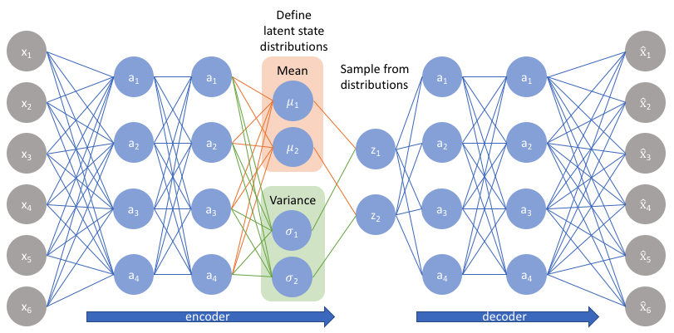
Implementation

Slide 18
Applications
Image generator¹
Image Denoiser¹
Anomaly Detection²
¹ Kingma, D.P., Welling, M.(2014) Auto-Encoding Variational Bayes.
² Adrian Pol, Victor Berger, Gianluca Cerminara, Cécile Germain, Maurizio Pierini. Anomaly Detection With Conditional Variational Autoencoders. ICMLA 2019 - 18th IEEE International Conference on Machine Learning and Applications, Dec 2019, Boca Raton, United States

Slide 19
Image generator

Slide 20
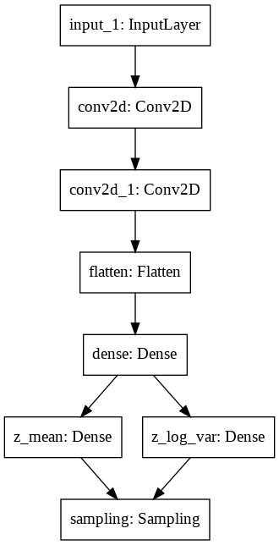
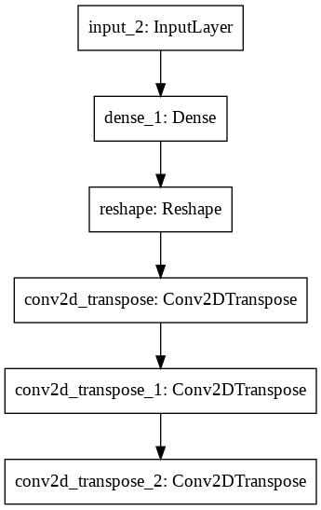
Training an Image generator
Model Architecture
Encoder
Decoder
Dataset: MNIST with images of digits 0, 1, 2, 3, 4, 5, 6, 7, 8, 9
Optimizer: Adam
Epochs: 100
Loss: KL Divergence Loss, Reconstruction loss
Additional Testing:
Dataset: CIFAR10 with images of 10 classes
Epochs: 400

Slide 21
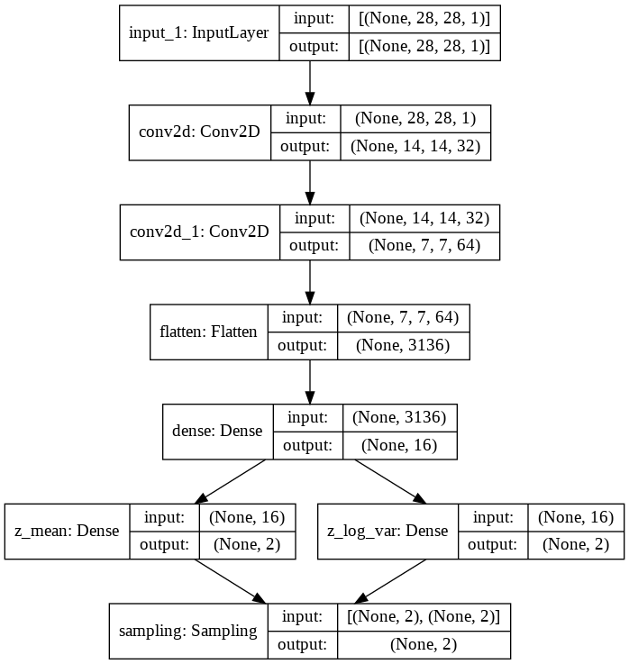
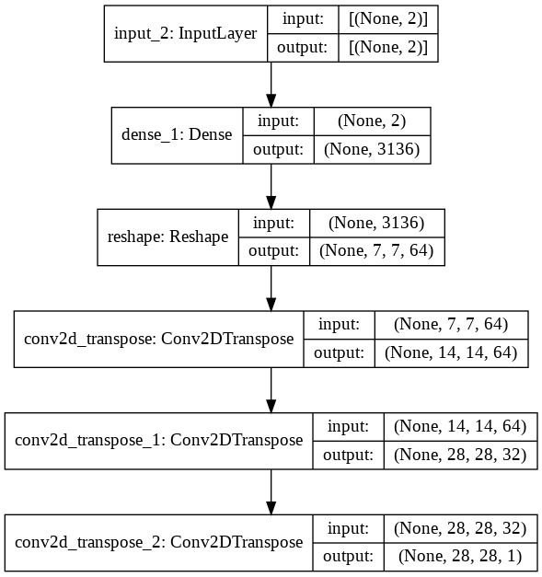
Model Summary

Slide 22
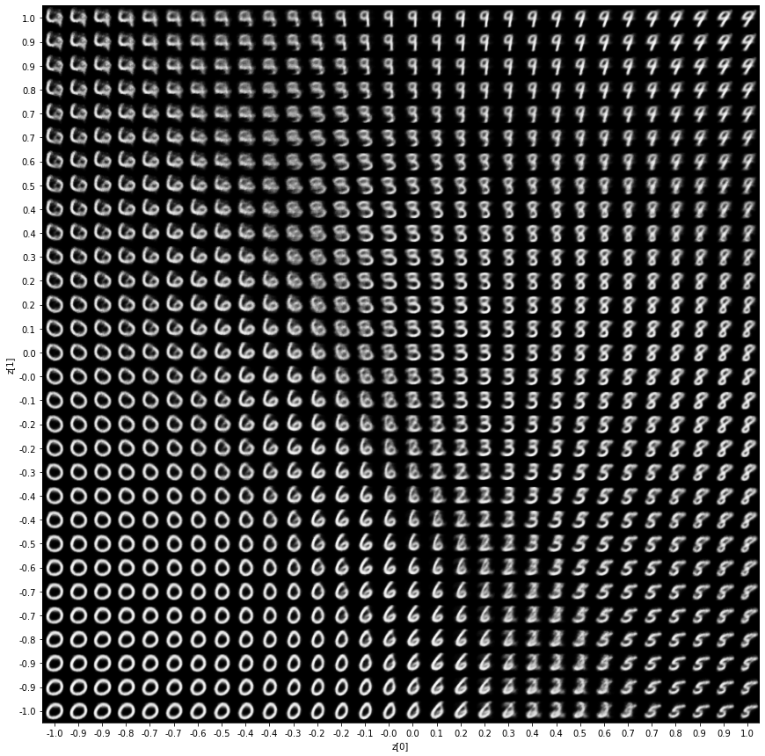
Image generator
Manifold Plot
Varying values (Mean and Variance) in Latent Vector between -1 to 1

Slide 23
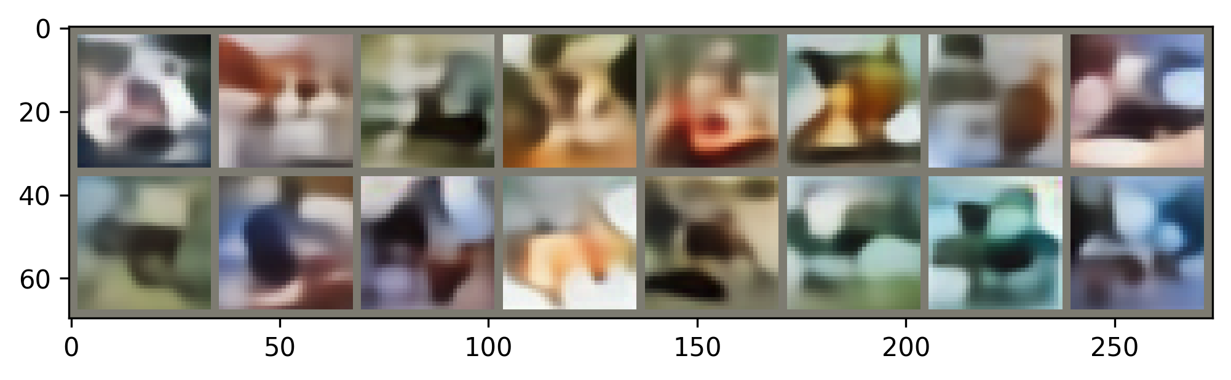
Limitations
Works well at lower resolution and lower dimensional images
Produces blurry Images
Need more training time and dataset for high dimensional images
Dataset: CIFAR10 with images of 10 classes
Epochs: 300

Slide 24
Image Denoiser

Slide 25
Image Denoiser
Model Architecture
Encoder
Decoder
Dataset: MNIST with images of digits 0, 1, 2, 3, 4, 5, 6, 7, 8, 9
Optimizer: Adam
Epochs: 100
Loss: KL Divergence Loss, Reconstruction loss

Slide 26
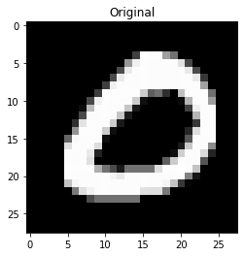
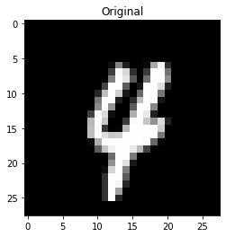
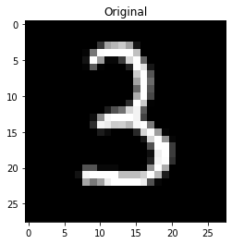
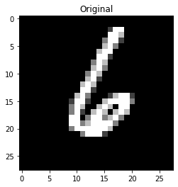
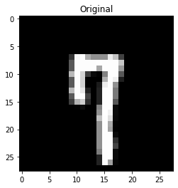
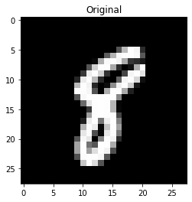
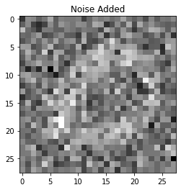
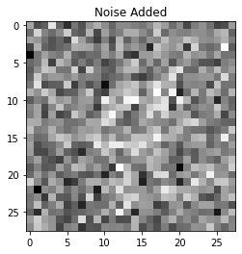
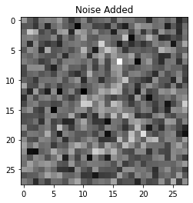
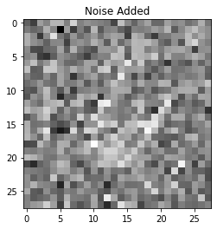
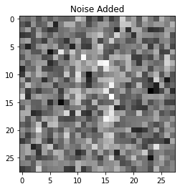
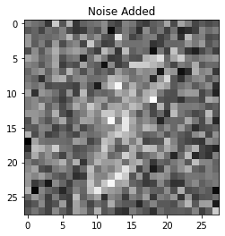
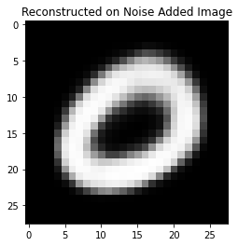
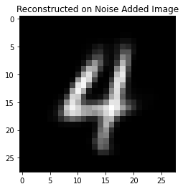
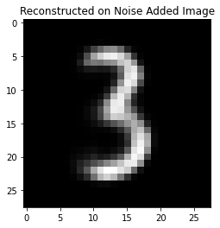
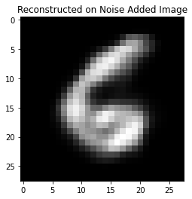
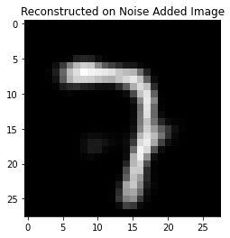
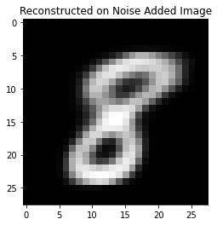
VAE as Denoiser/ Sparse Generator

Slide 27
Limitations
Reconstruction is perfect only for digits that we have trained
Reconstruction is possible for the even with moderate-high noise
Works well at lower resolution and lower dimensional images
Produces blurry Images
Reconstruction capabilities becomes low when the noise is extreme

Slide 28
VAE for Anomaly Detection

Slide 29
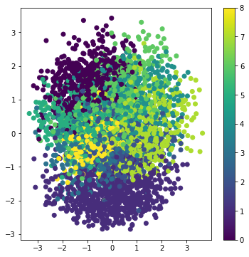
VAE for ¹Anomaly Detection
Train a VAE model of digits 0, 1, 2, 3, 4, 5, 6, 7, 8
Use digit 9 for testing anomalies
Optimizer: Adam
Epochs: 100
Loss: Reconstruction loss, KL Divergence Loss
¹Adrian Pol, Victor Berger, Gianluca Cerminara, Cécile Germain, Maurizio Pierini. Anomaly Detection With Conditional Variational Autoencoders. ICMLA 2019 - 18th IEEE International Conference on Machine Learning and Applications, Dec 2019, Boca Raton, United States

Slide 30
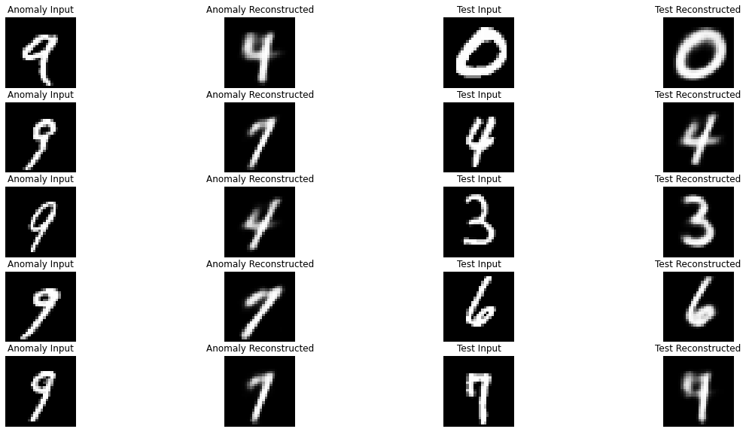

Slide 31


Slide 33



T-SNE plot of Latent distribution
1
AUC – 0.63 for Anomaly detection
2
Reconstruction Loss
4
6
Green - Training data
Red - Anomaly data

Slide 34

Limitations of VAE
Element-wise reconstruction error
- Loss of Texture and important features in Output
Usually use a fixed standard normal distribution as prior
- Introduces Gaussian Blurring effect
Image: Larsen et al., 2016

Slide 35
VAE is still relevant!
Jung, Y., Kim, Y., Choi, Y., Kim, H. (2018) Joint Learning Using Denoising Variational Autoencoders for Voice Activity Detection. Proc. Interspeech 2018, 1210-1214, DOI: 10.21437/Interspeech.2018-1151.
Bando, Y., Sekiguchi, K., Yoshii, K. (2020) Adaptive Neural Speech Enhancement with a Denoising Variational Autoencoder. Proc. Interspeech 2020, 2437-2441, DOI: 10.21437/Interspeech.2020-2291.
Zilvan, Vicky & Ramdan, Ade & Suryawati, Endang & Kusumo, R. & Krisnandi, Dikdik & Pardede, Hilman. (2019). Denoising Convolutional Variational Autoencoders-Based Feature Learning for Automatic Detection of Plant Diseases. 1-6. 10.1109/ICICoS48119.2019.8982494.
… and so on…

Slide 36

¹GANS – Successors of VAE?
¹Goodfellow, I.J., Pouget-Abadie, J., Mirza, M., Xu, B., Warde-Farley, D., Ozair, S., Courville, A., Bengio, Y., 2014. Generative Adversarial Networks.

Slide 37


Slide 38



Slide 39
Two Application of GANs
Creating Line Art from Photo-realistic Images
Creating Photo-realistic Images from Line Art

Slide 40


Dataset¹:
490 Images and corresponding line arts
¹Yi, R., Liu, Y.-J., Lai, Y.-K., Rosin, P.L., 2019. {APDrawingGAN}: Generating Artistic Portrait Drawings from Face Photos with Hierarchical GANs, in: {IEEE} Conference on Computer Vision and Pattern Recognition (CVPR ’19). pp. 10743–10752.

Slide 41

Model: UNET Architecture with Resnet34 as Base Encoder and inverted Resnet34 as Decoder
Loss Function:
VGG19 Feature loss (Generator)
Binary Cross Entropy (Discriminator)

Slide 42

Input
Predicted
Original
Test Results
Line art from Photo-realistic Images
No of Epochs: 200
Discriminator Loss: 0.357917 Generator Loss loss: 0.154651

Slide 43

Input
Predicted
Original
Test Results
Photo-realistic Images from Line art
No of Epochs: 400
Discriminator Loss: 0.661652
Generator Loss loss: 0.278885

Slide 44
Limitations of GANs
Instability of training (Requires careful balance between the training of G and D)
More Training Time
Chances of Overfitting
Unable to control the attributes of generated samples and hence unrealistic images are generated

Slide 45

Future Works
Reference
J. Bao, D. Chen, F. Wen, H. Li and G. Hua, "CVAE-GAN: Fine-Grained Image Generation through Asymmetric Training," 2017 IEEE International Conference on Computer Vision (ICCV), 2017, pp. 2764-2773, doi: 10.1109/ICCV.2017.299.

Slide 46

Reference
J. Bao, D. Chen, F. Wen, H. Li and G. Hua, "CVAE-GAN: Fine-Grained Image Generation through Asymmetric Training," 2017 IEEE International Conference on Computer Vision (ICCV), 2017, pp. 2764-2773, doi: 10.1109/ICCV.2017.299.

Slide 47
Conclusion
We built three different applications using Variational Autoencoder namely
- Image generator
- Image Denoiser
Anomaly Detection
We analyzed the latent space parameters and its influence on output
We also explored the power of GANs as Generative models by building two different Experiments on generating Line art from Photo-realistic Images and vice-versa.

Slide 48
Thank you

